Slide 1
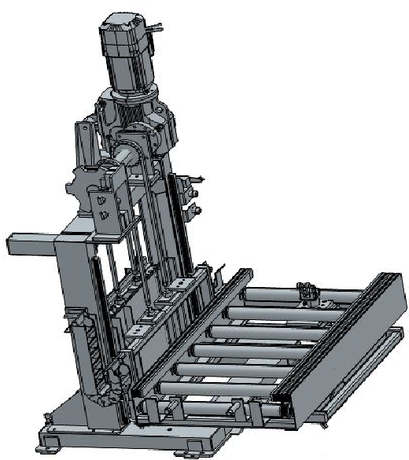
Pallet Lifter with Roller conveyor:-
Roller conveyor in line are used to receive and deliver Pallet with body to the lifter unit.

Slide 2
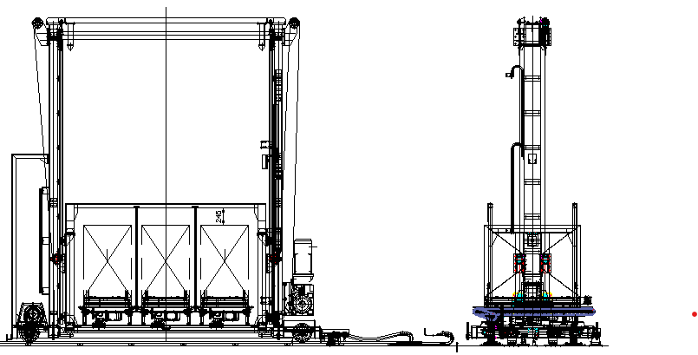
Shuttle with Chain Conveyor:-
This is used for pallets loading and unloading in truck. This is semi-automatic system.

Slide 3
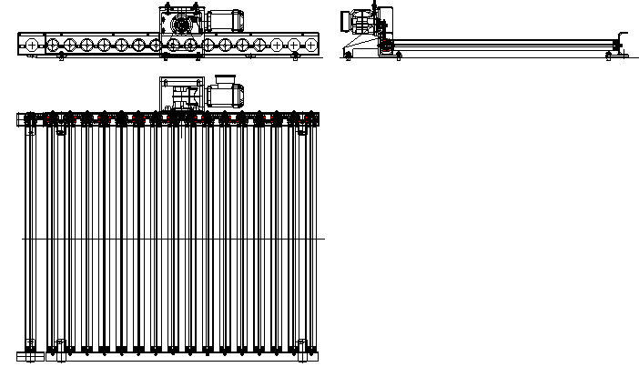
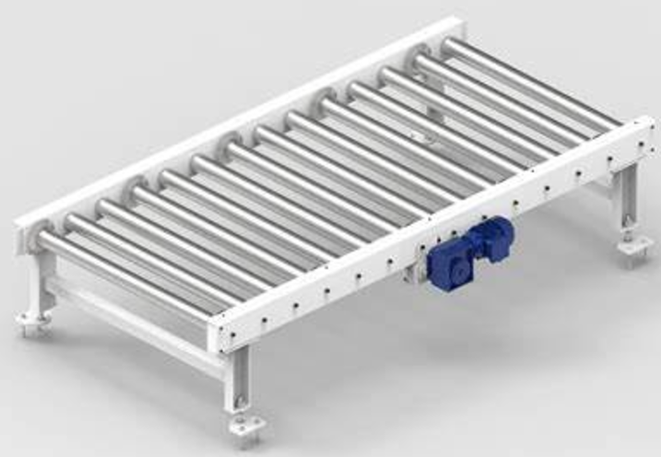
Positive Roller Conveyor-
Roller conveyors are used for transfer material within specified zone for pallet/Carton box conveying application. The roller may be PU coated or Metallic is depends on its applications.
Powered Roller conveyor

Slide 4
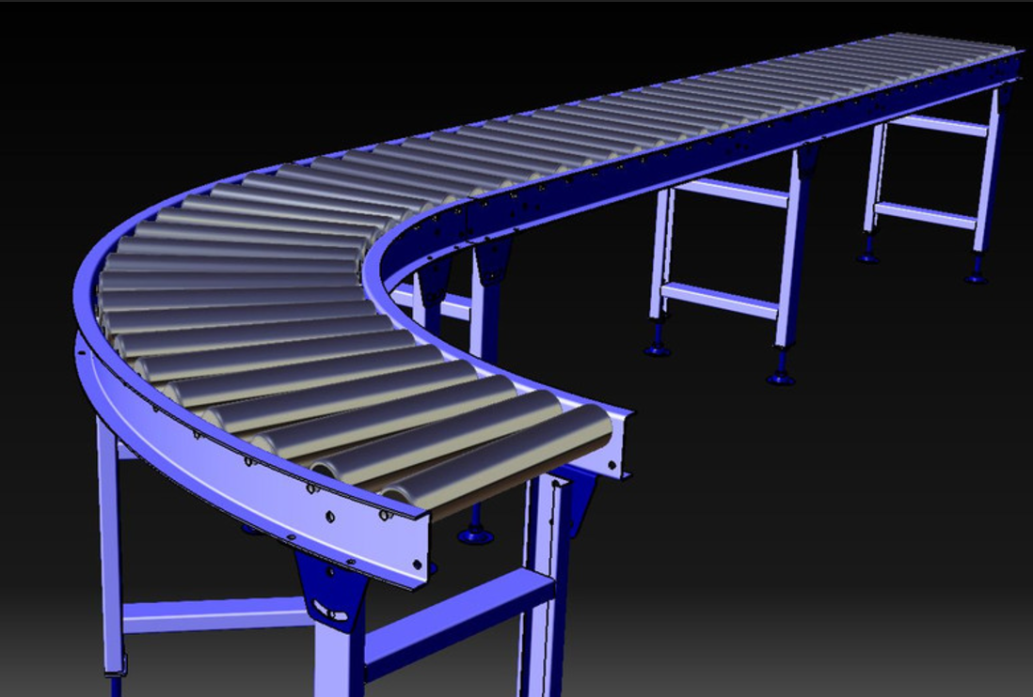
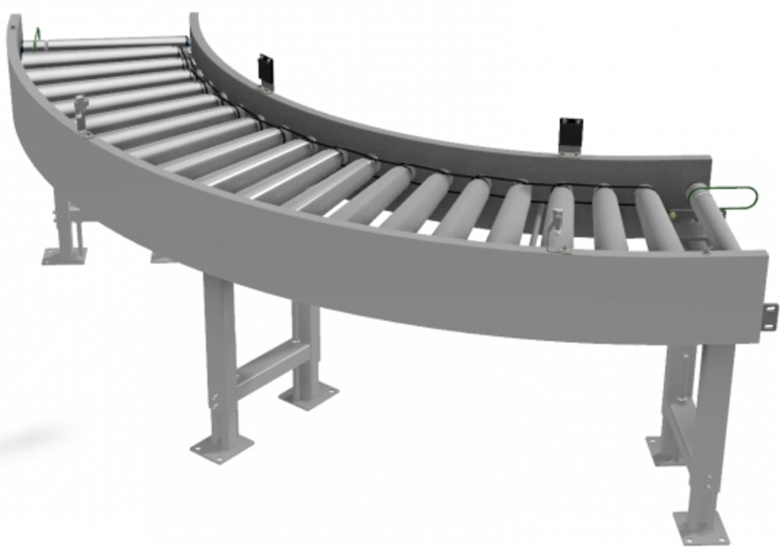
Curved roller Conveyor-

Slide 5
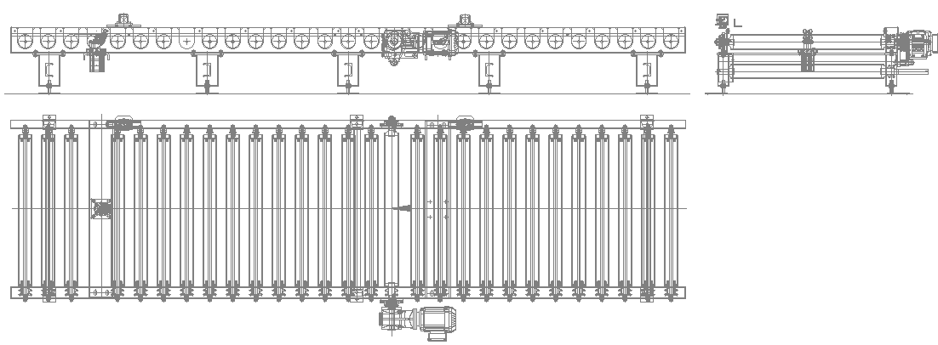
Accumulation Roller Conveyor-
Accumulation roller conveyor used for accumulation the pallets on roller conveyor.

Slide 6
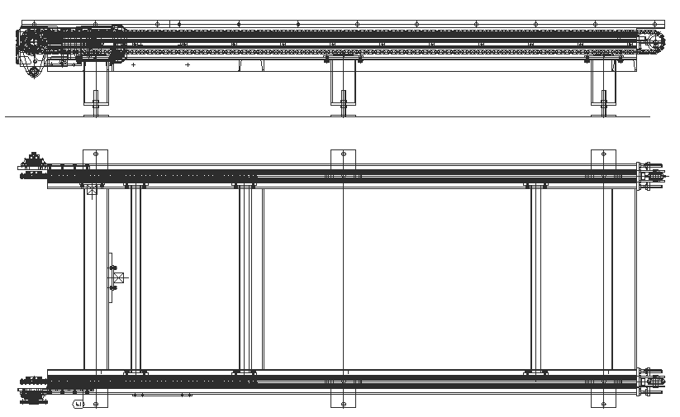
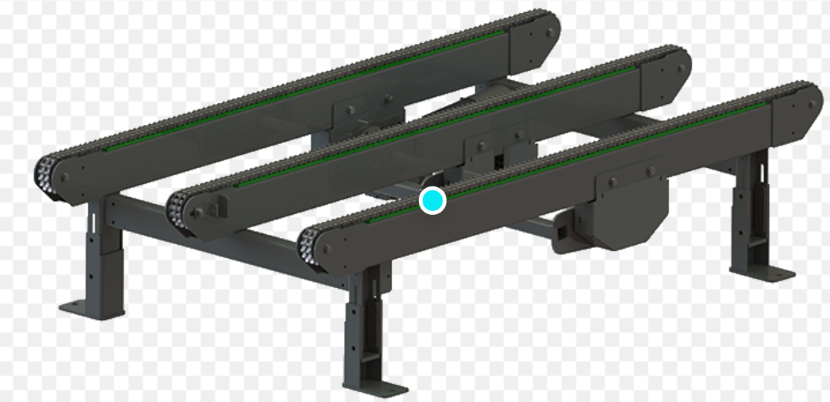
Positive Chain Conveyor:-
Chain conveyors are used for moving products down an assembly line and around a manufacturing or warehousing facility.
Chain conveyors are primarily used to transport heavy unit loads, e.g. pallets, grid boxes, and industrial containers.

Slide 7
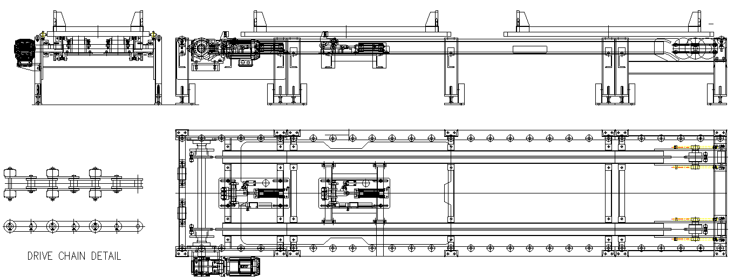
Accumulation Chain Conveyor-
It is designed to transport and accumulate the pallet.
Accumulation Chain conveyor

Slide 8
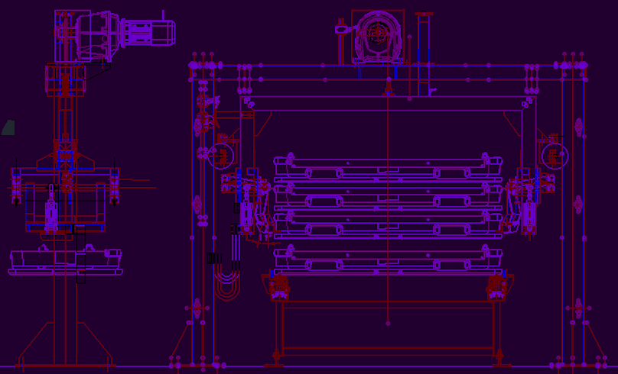
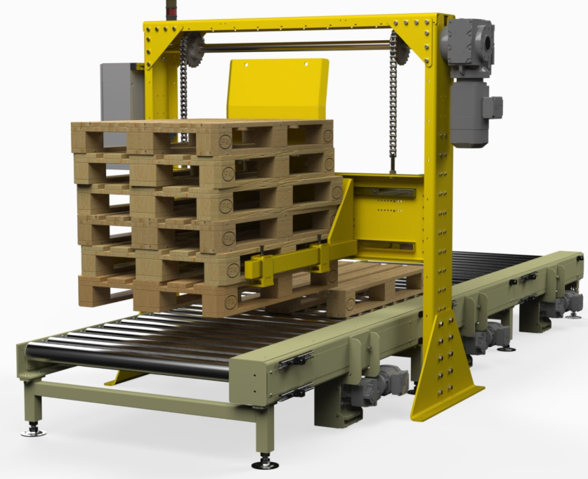
Pallet Stacker/De-Stacker:-
It is used for pallet stacking or de-stacking purpose. Lifting and arm actuation mechanism is motorized/pneumatic type as per application. It is used for wooden or metallic pallet also.
Pallet stacker/De-stacker

Slide 9
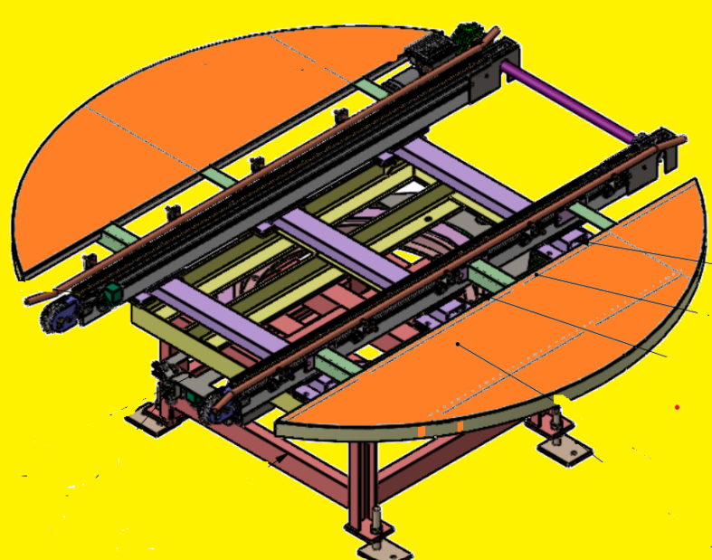
Turn table:-
It is used for pallet orientation change as per required position.
Turn table with Chain conv.

Slide 10
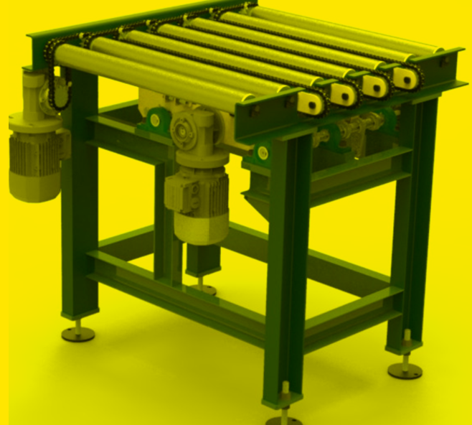
Pop Up with Roller conv:-
It is used for pallet cross transfer.

Slide 11
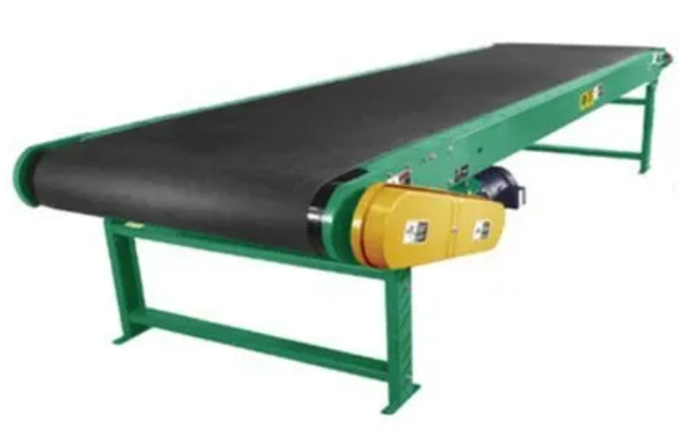
8. Belt Conveyor:-
Belt conveyors are used to transport the material in a straight line or at inclined or declined slope. Different types of belts have to be used as per the product requirements. This type of belt widely used for Bulk material handling as well as individual product handling at much higher speeds than other conveyor types. Belt conveyors also used for skid cross transfer purpose.
A typical view of Belt conveyor

Slide 12
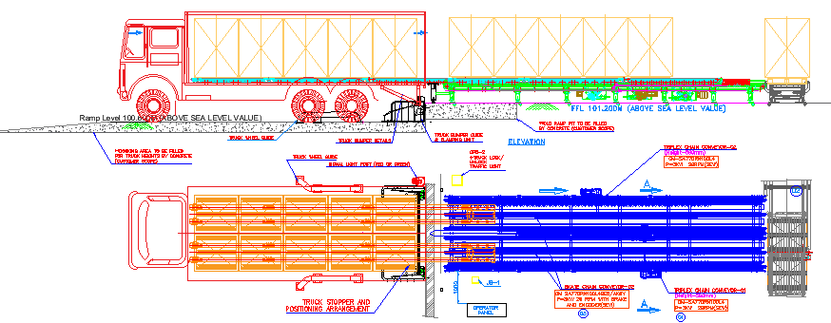
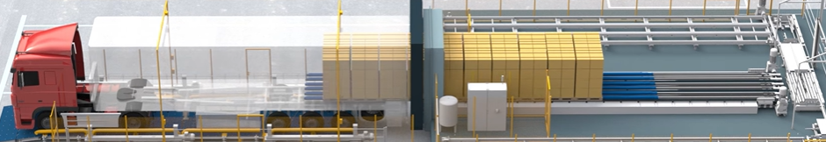
Automated Pallet Unloader Machine
Pallets from truck can be unloaded automatically by this system. This system includes Pneumatic Fork lifting system, Motorized Pallet and fork transfer system.
The system is designed as per truck and Pallet size.
10. Two mast Lifter

Slide 13
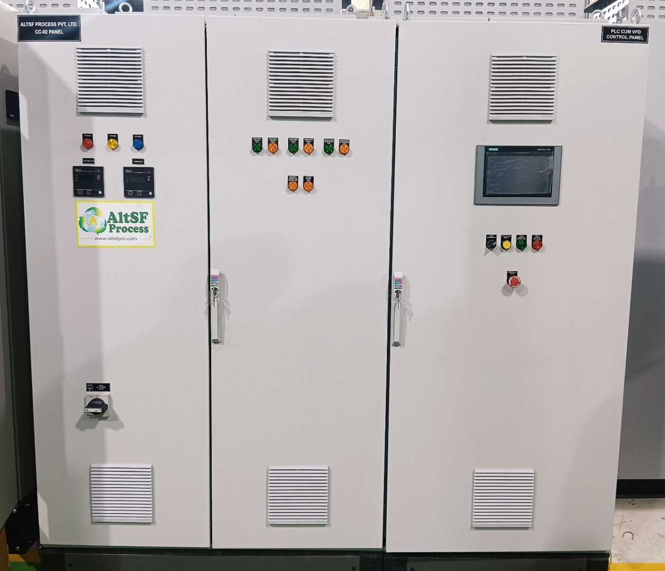
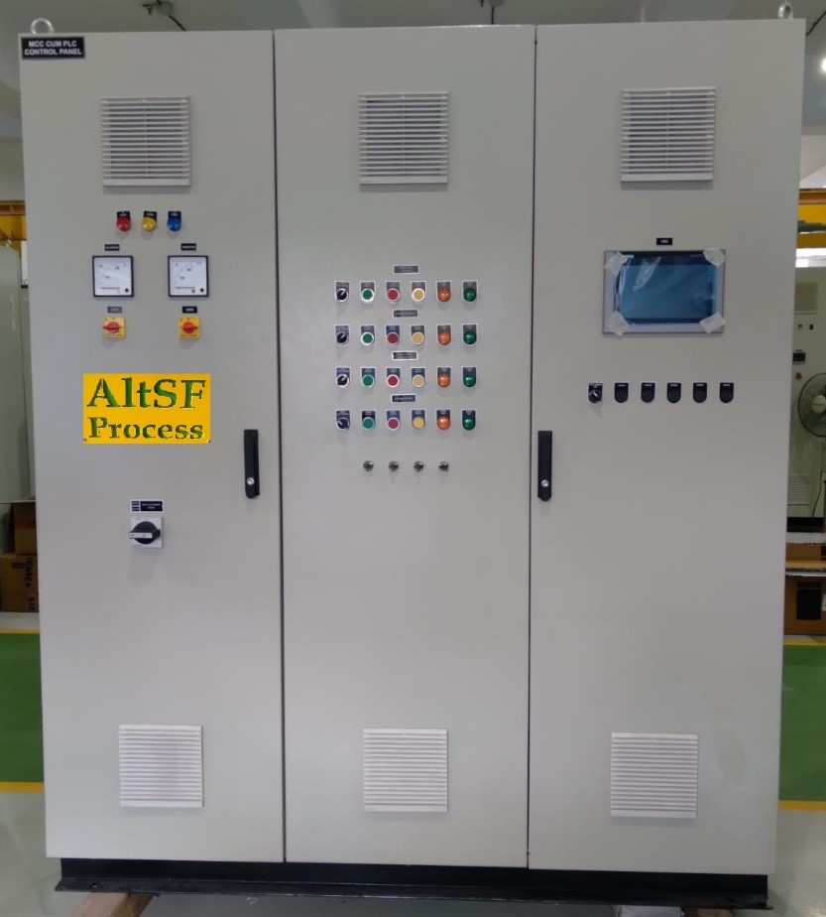
Control Panel-
A vast array of technology including's PLC’s PCs, networked client system, DCS, application specific software packages provide a comprehensive range of controls capability.

